Slide 1
Machine Learning in Research of Eyes
Prepared by: Kossov Assylbek
Bektemirova Aruzhan
Kassanov Roman

Slide 2

The current problem
The lack of research in brain eye relationship

Slide 3
Competitors
University of Massachusetts
Harvard Medical School
Stanford Medical School
Boston University of Medicine
And etc…………..

Slide 4
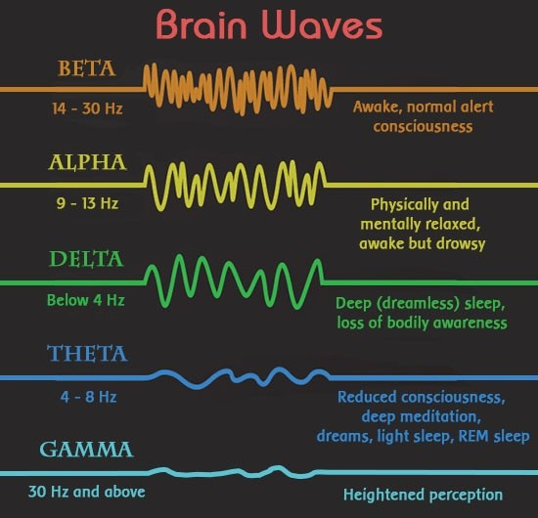
Types of waves

Slide 5
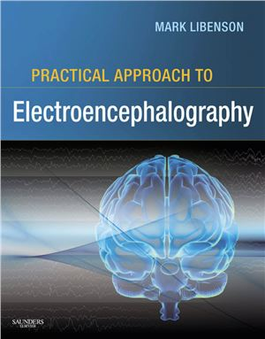
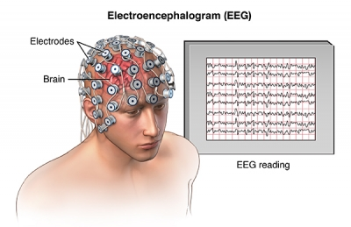
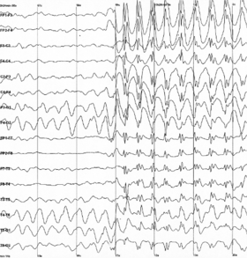

Slide 6
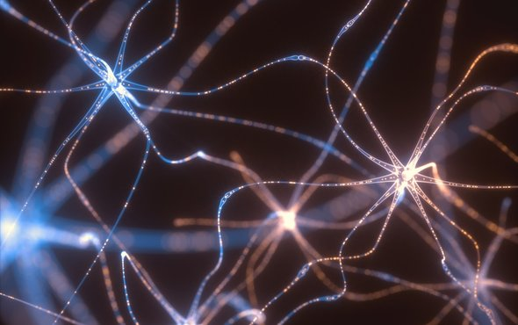
How to Predict Whether a Persons Eyes are Open or Closed Using Brain Waves

Slide 7
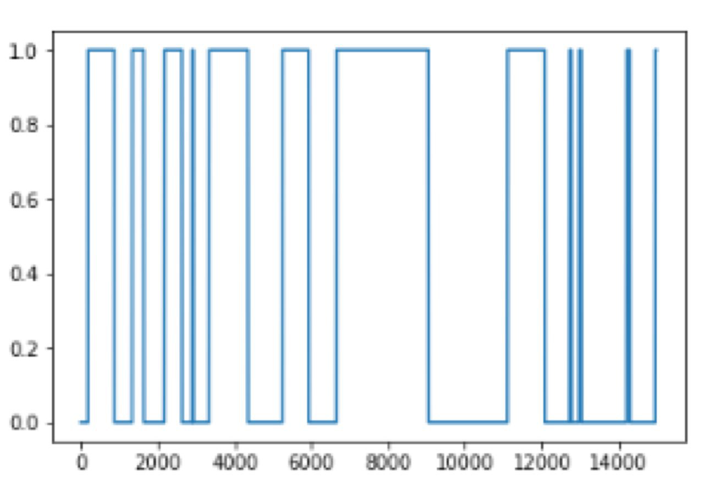

Slide 8
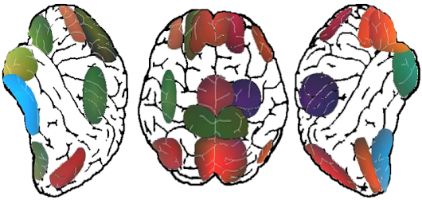

Slide 9
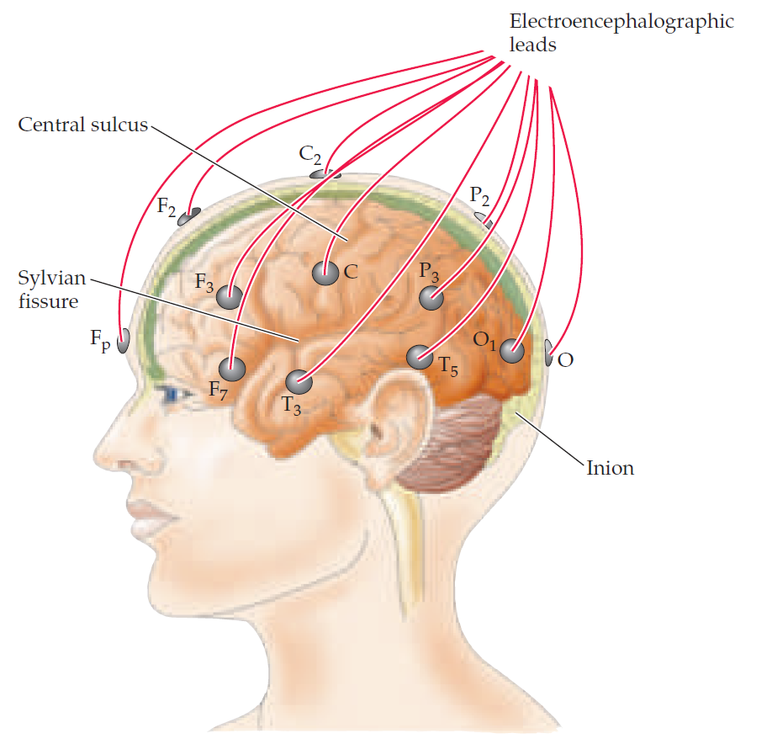

Slide 10
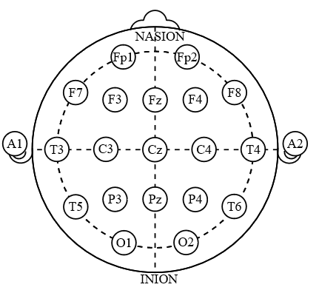

Slide 11
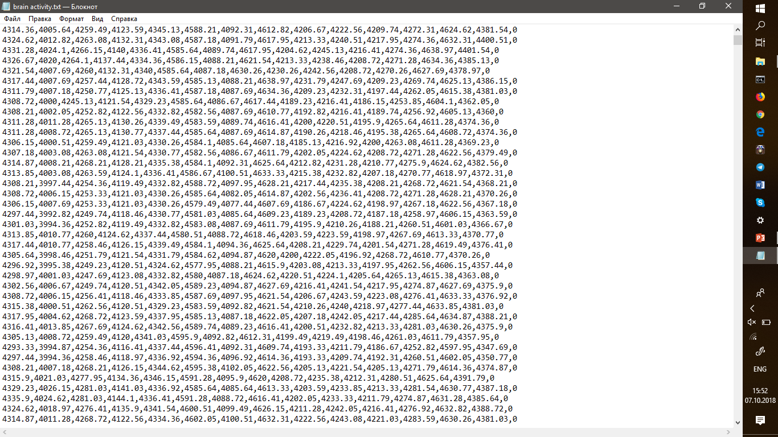
DATASET
Consists from coordinates of brain signals

Slide 12
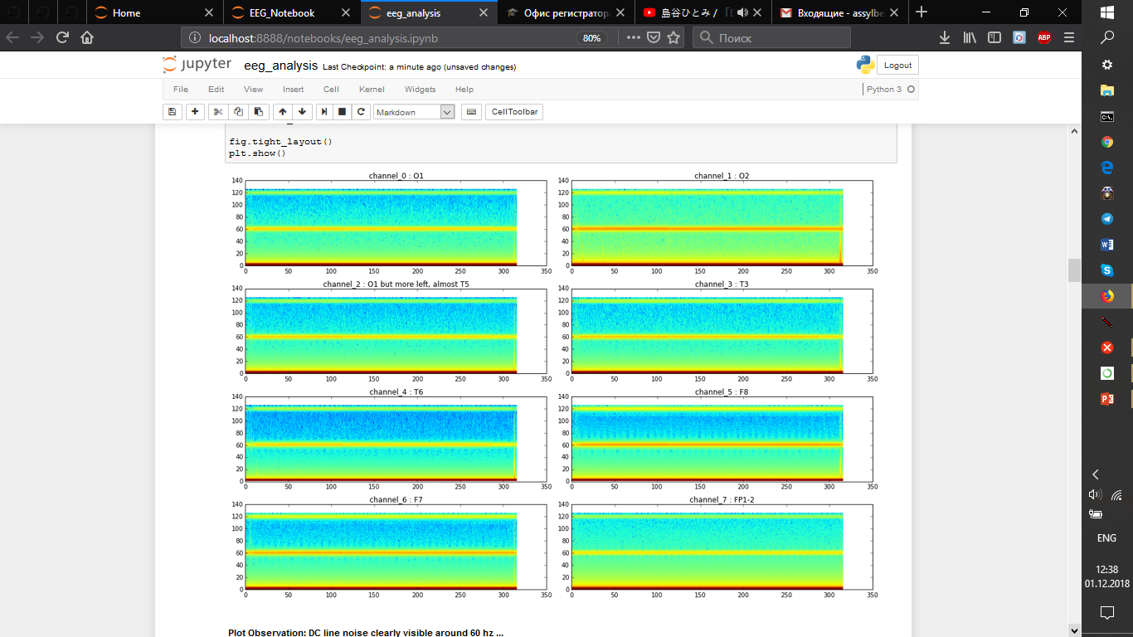

Slide 13
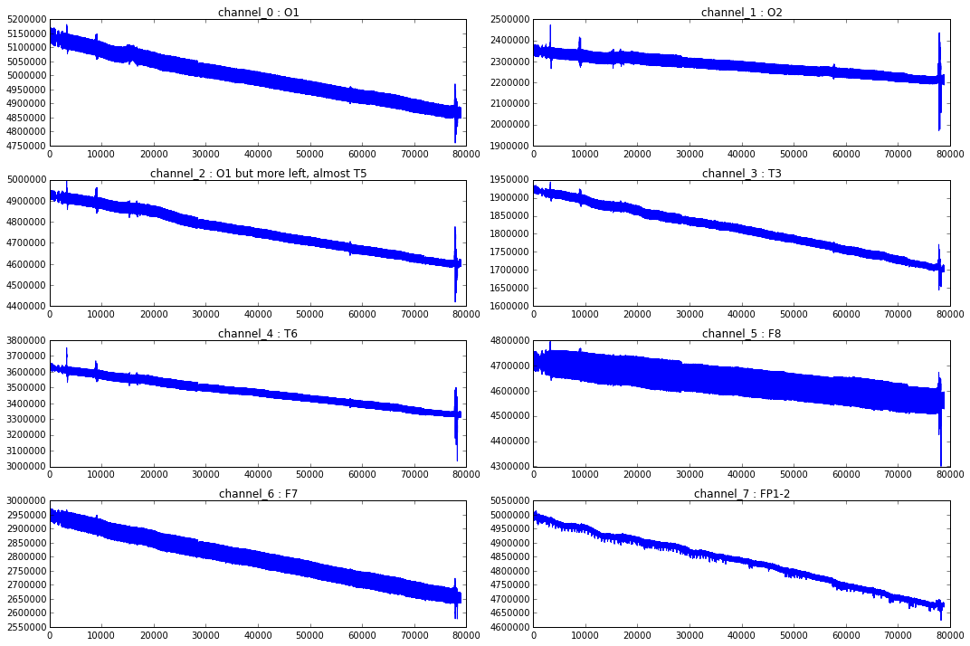

Slide 14
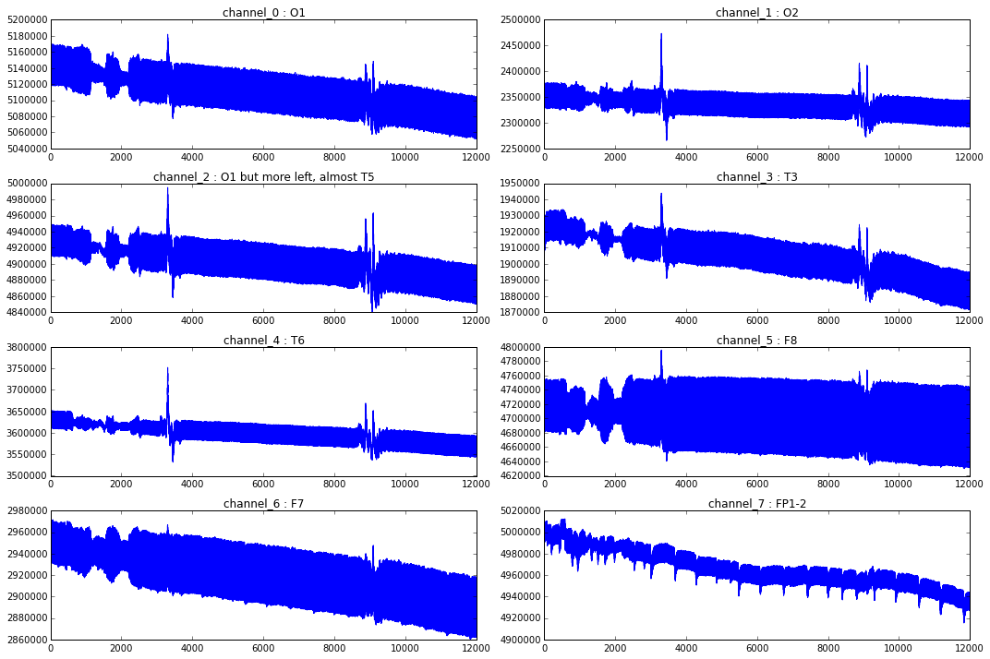

Slide 15
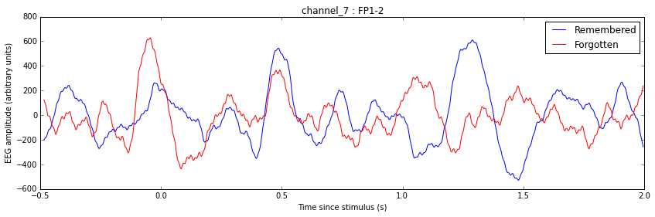

Slide 16
Thank you !!!
IT’S TIME FOR QA

